Slide 1


The Wonderful World of our Gut Microbiome
& its link to Parkinson’s
Caroline Peyton
Nutritionist, Naturopath, Gut Health Expert
Cotswolds

Slide 2
About Me
14 years in Clinical Naturopathic Nutrition Practice
Gut Health Expert
20 years corporate management background
Corporate workshops to help fuel and energise managers and their teams to perform at their best
“Passionate to help people lead a happier, healthier more active life”
Notes:
Fully trained insured in NT, ND, iR, wellbeing coaching
Gut health: personalised programmes enabling those suffering with unresolved symptoms to find relief

Slide 3
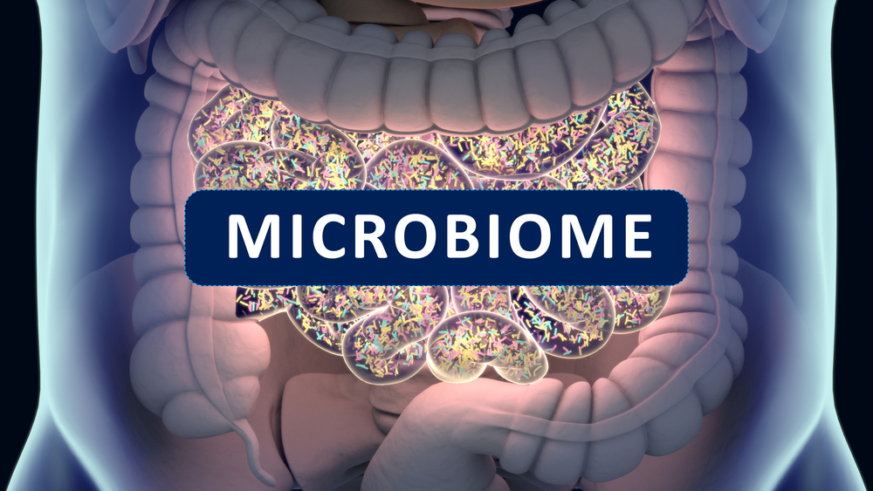
Notes:
Not truly representative

Slide 4
What is it?
An ecosystem of diverse micro-organisms:
Bacteria, viruses, fungi – even parasites
Colonise the gastrointestinal tract: stomach, small intestines, colon, rectum
Most are found in the colon
Mutually beneficial “symbiotic” relationship
Notes:
Beneficial WHEN ALL IS WELL!

Slide 5
Did you know……..?
Estimated 100 trillion microbes- 10 X the cells in your body!
You have more microbes in your gut than there are people in the World
Weighs 1-2Kg
We each have approx. 160 different species (1000 identified)
70% of your immunity starts here
90% of disease can be linked to gut health
Now recognised as another organ in the body
“Today’s understanding - tomorrow’s understanding will be even more mind-blowing”

Slide 6

Dysbiosis
Very often ***CHAOS*** occurs!!!!

Slide 7
Dysbiosis- Definition
“An imbalance in your gut between “good” bacteria and “bad” pathogens that contribute to chronic conditions and ill health”

Slide 8
Gut Brain Axis
Separate nervous system connects gut directly with the brain “Enteric Nervous System”
2-way flow of communication via neurotransmitters (hormone like chemicals)
90% serotonin and 50% dopamine produced in gut
Gut is influencing mind, brain & behaviour
Notes:
Neurotansmitters: dopamine, GABA, serotonin
CANNOT CROSS BBB or can it??
Feeling of butterflies in your stomach?

Slide 9
Microbiome Disruption and Parkinson’s
Lack of abundance of commensal bacteria
Increase in pro-inflammatory pathogens
Breakdown of the mucosal gut barrier
Toxicity passes through “leaky” gut and may trigger
▶️ Systemic inflammation
▶️ Over stimulation of the immune system
▶️ Over accumulation of proteins in neurons and cell death (degeneration) leading to loss of dopamine
Nervous System Degeneration

Slide 10
What does the Research tell us?
Conclusion
Parkinson’s Disease is accompanied by dysbiosis of the gut microbiome
Notes:
Lack of SCFA bacteria - butyrate

Slide 11
Curious?
Test to discover your unique microbiome community →
“72 markers that give clarity how your gut impacts your health”
DNA based “PCR” test CQC quality (aligned with NHS standards)
From Inflammation to Intestinal Permeability → “Leaky gut”
From Digestive capability to Gut Immunity capability
From Beneficial ESSENTIAL bacteria to pathogens, parasites, yeasts and more!

Slide 12
Get in touch
caroline@peytonprinciples.com
Website: www.peytonprinciples.com
t: 07730 513303
Join my Facebook Group: “Inspired Lifestyle Choices for Women over 35”
You Tube Channel: Peyton Principles Natural Health
Instagram: peytonprincipleshealth
**NEW** Podcast “Nutrition Life Stories”

